Slide 1
Acropolis institute of technology and research
MAJOR PROJECT
EVENT MANAGEMENT SYSTEM
SUBMITTED BY: ALISHA SHEIKH
ANJALI MENGHWANI

Slide 2
PROJECT CATEGORY: WEBSITE
TOOLS AND TECHNOLOGIES USED:
Tools used: My Sql
Technologies used: HTML, CSS, JavaScript

Slide 3
ABSTRACT
Our main aim of this project is to make and provide an ideal software solution to register- events ,to cancel event ,to protect user data and to save the valuable time of the user
To fulfill the requirements of user
To make the user friendly software for easy registration and also give feedback for a particular event.

Slide 4
introduction
This project performs the task of developing a web application that enables the students and faculty to retrieve the data very easily.
The main purpose of event management system is to provide a platform for the users to view the information about the events that took place in the past and the ones which are about to take place in the near future.
The users can be faulty, students and administrator.
They can first login into the website and see through the information such as details about the events like the venue, theme of the event , participants, chief guests ,etc.
The faculty can keep the record of the attendance also .
The administrator can login and update the information ,delete any unwanted data ,arrange the information accordingly so that the user can go through an user friendly and know all the whereabouts of their college

Slide 5
problem statement
The project idea is to develop a system which will useful for any information regarding particular event can easily access to the event staff coordinators, HOD, student coordinator and participants.
Event is organized in almost all the colleges but all the work done is manually. The events are decided and then asked to students whether they will coordinate or not then all the details are maintained in files manually. Many colleges have websites for events that they organize but this website is used for displaying the various events details that are going to be conduct in those colleges for informing the other college students. Students also not get the proper platform for finding events which helps to build their resume. There is no such android application or web application for Event management or organization by which automatic record will maintain, also show all events to participants by which they can apply online and event can be organized.

Slide 6
PROJECT OBJECTIVES
The main goals of the project are: -
To reduce the communication gap between students / participants and event coordinators of the events.
-Online registration / application of participants.
-Proper utilization of the schedule and digital resources
.
-Easy to assign students for campaigning.
-To reduce the overhead of the organizing committee

Slide 7
SOLUTION PROPOSED
.
We proposed the solution for event management and try to overcome the problem of paper work in the registration process . This is easy to use, flexibility in registration and a user can also get the details about event and also give feedback for that event.
The proposed system is dedicated for the Events Organizing purpose.
The applications of the proposed system is, to communicate/messaging between event organizer and participants formally.
To notify the changes done in the event schedule.
To exchange the data between students and staff coordinators.
To display all events to participant and they can apply online.
To convey any important message to students coordinators or participants.

Slide 8
survey
WIKIPEDIA
[1]. Event Management System: International Journal of Trend in Research and Development, (IJTRD) Volume 3 Issue 2 Page 121-123, 2016, ISSN 2394-9333
[2]. Review on Academic Information Exchange Messanger (AIEM): International Research Journal of Engneering and Technology (IRJET) Volume 3 Issue 3 Page 889-891, Mar 2016, ISSN 2395-0056 [2]. Google Cloud Messaging (GCM): cloud messaging service https://developers.google.com/cloud-messaging/gcm
[3]. GoogleApp Engine: https://cloud.google.com/appengine [4]. Software Engineering: A practitioner approach, 5th Edition, Roger S. Pressman
DISADVANTAGES:
lot of paper work required.
Man power was more.
Time consuming process.

Slide 9
OTHER BENIFITS
User friendly interface
Easy registration in different events
Less paper work

Slide 10
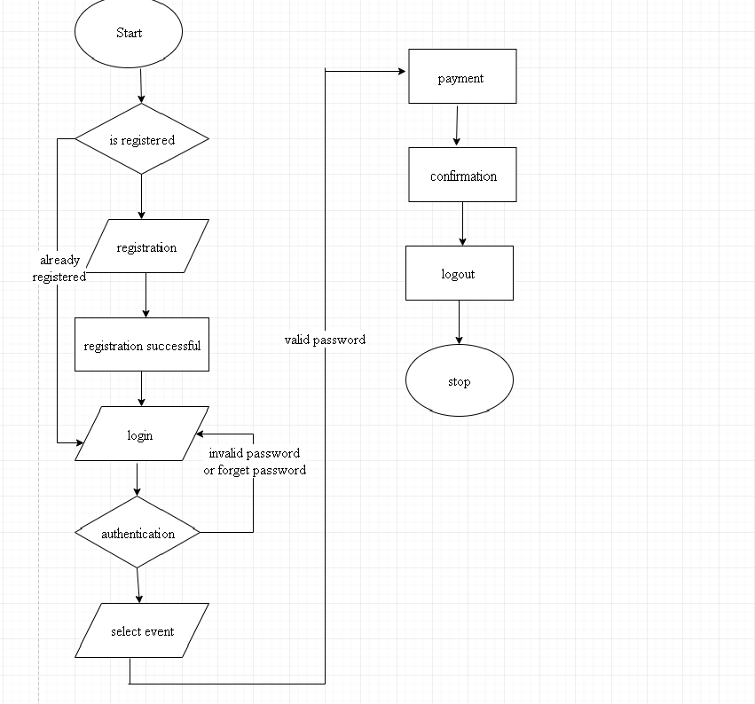
Flow chart

Slide 11
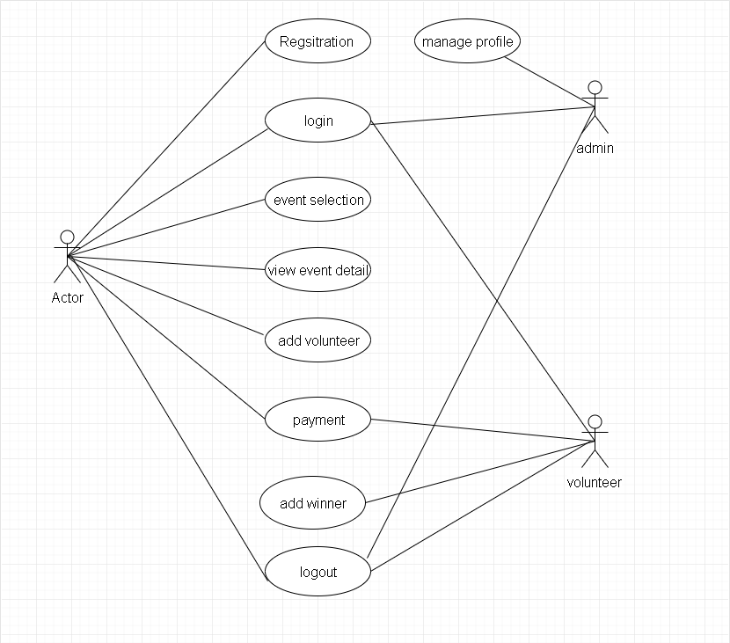
Use case diagram

Slide 12
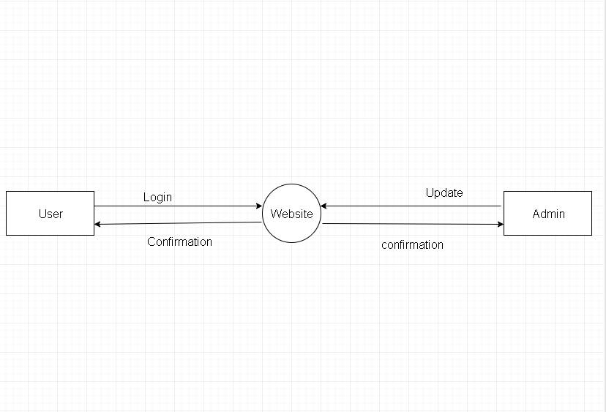
Data flow diagram-level 0

Slide 13
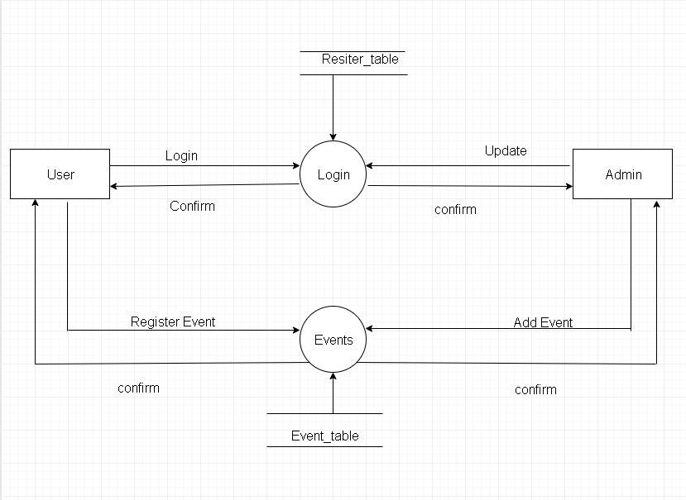
Data flow diagram- level 1

Slide 14
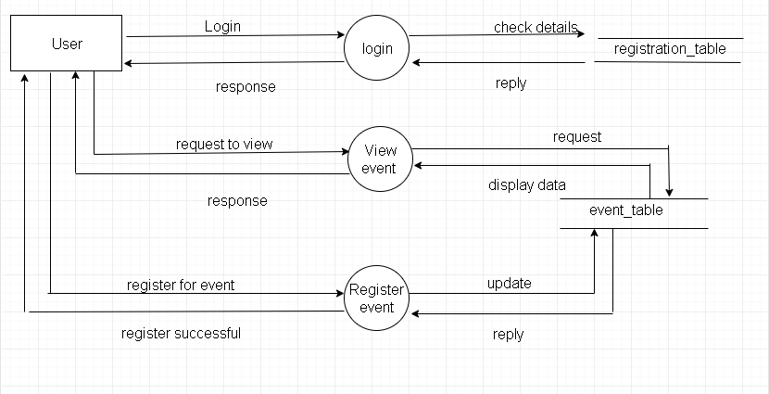
Data flow diagram- level 2 user

Slide 15
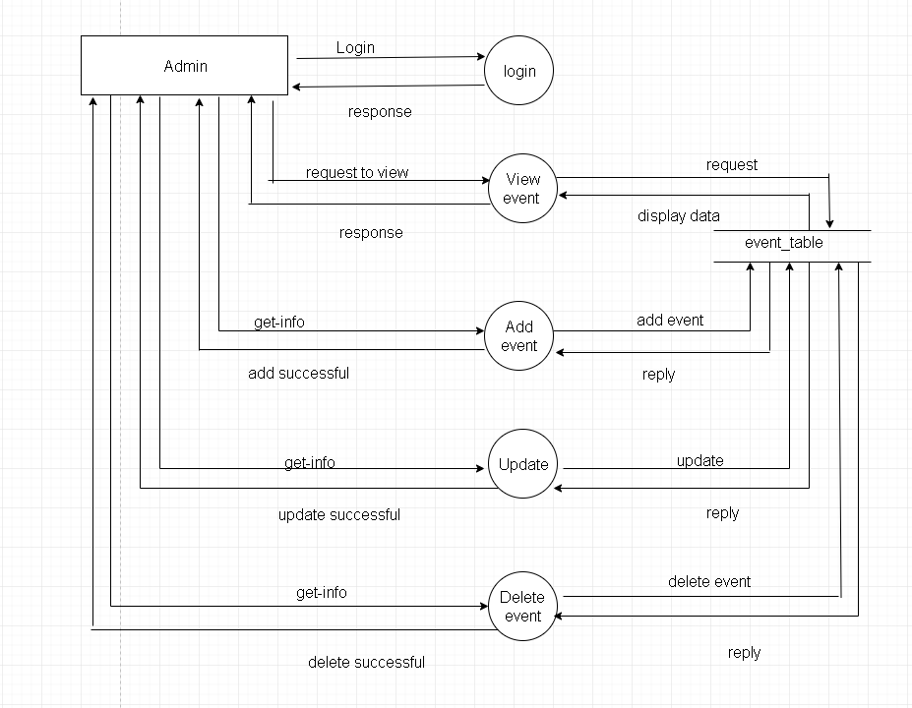
Data flow diagram-level 2 admin

Slide 16
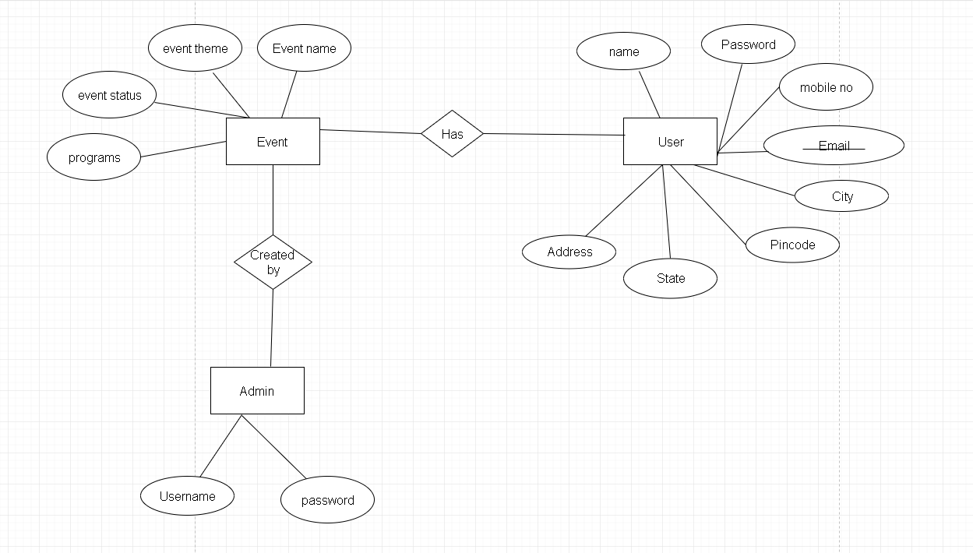
E-r diagram

Slide 17
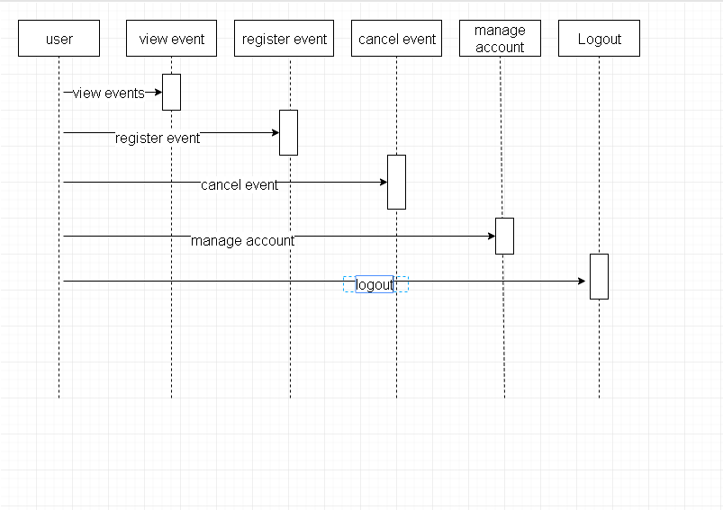
Sequence diagram-user

Slide 18
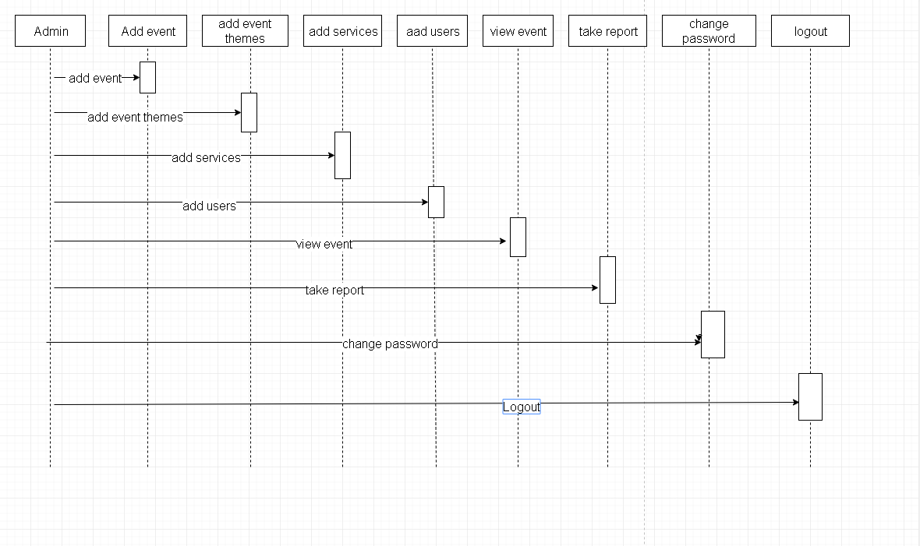
Sequence diagram-admin

Slide 19
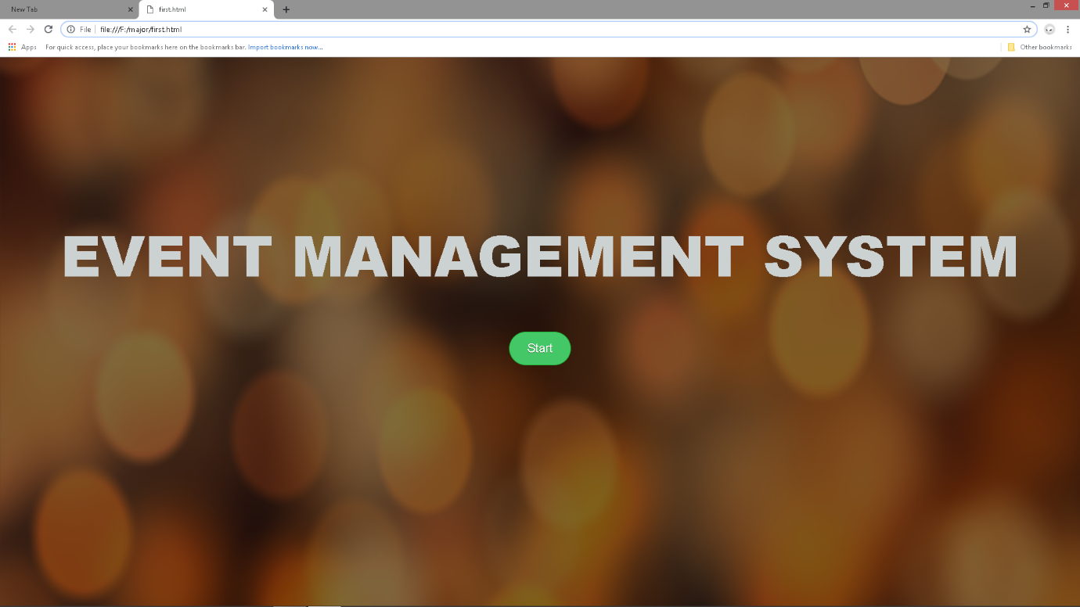
Screenshots of implementation

Slide 20
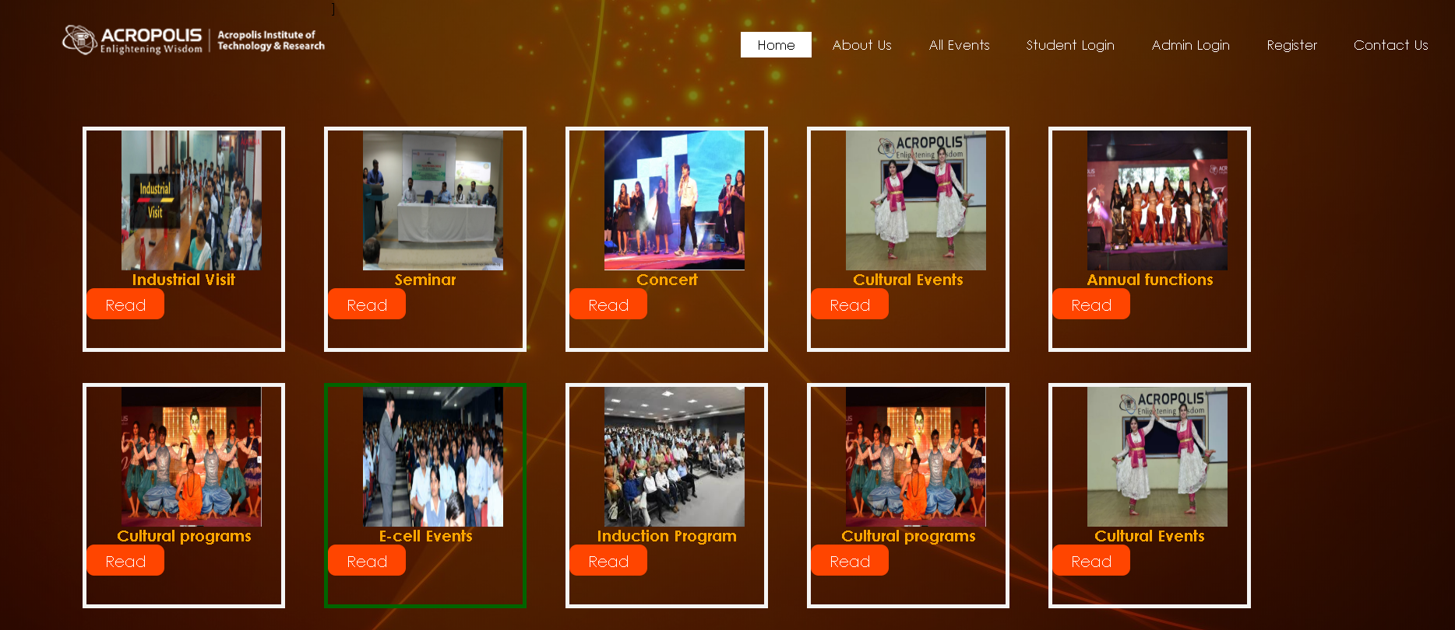

Slide 21
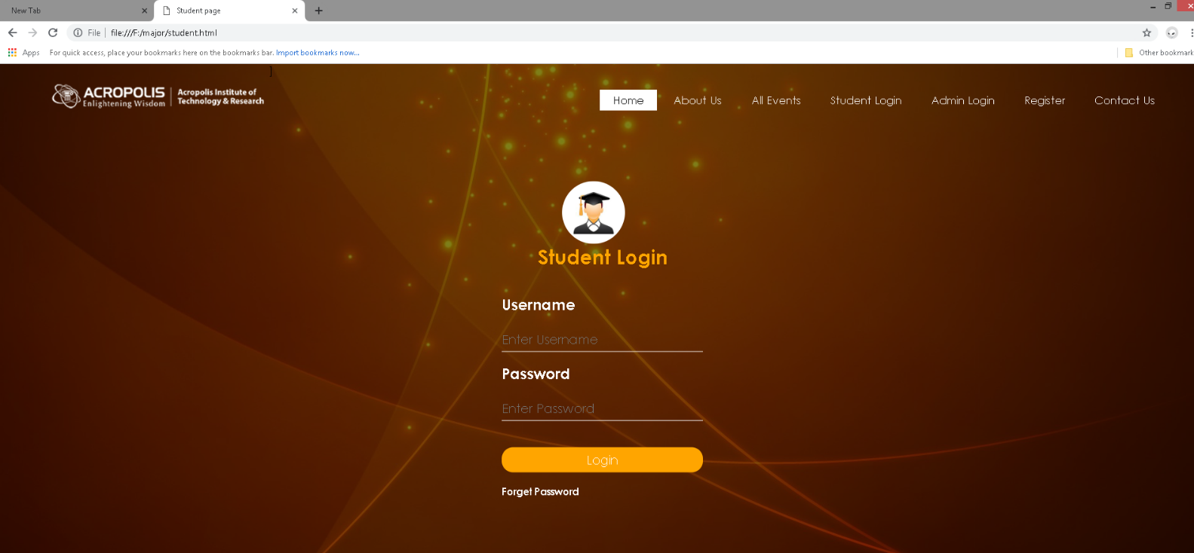

Slide 22
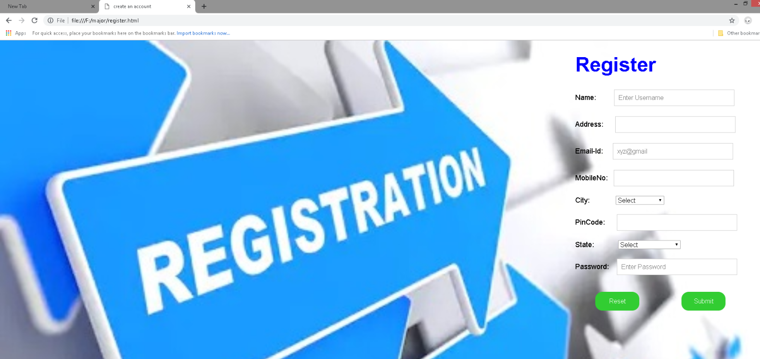

Slide 23
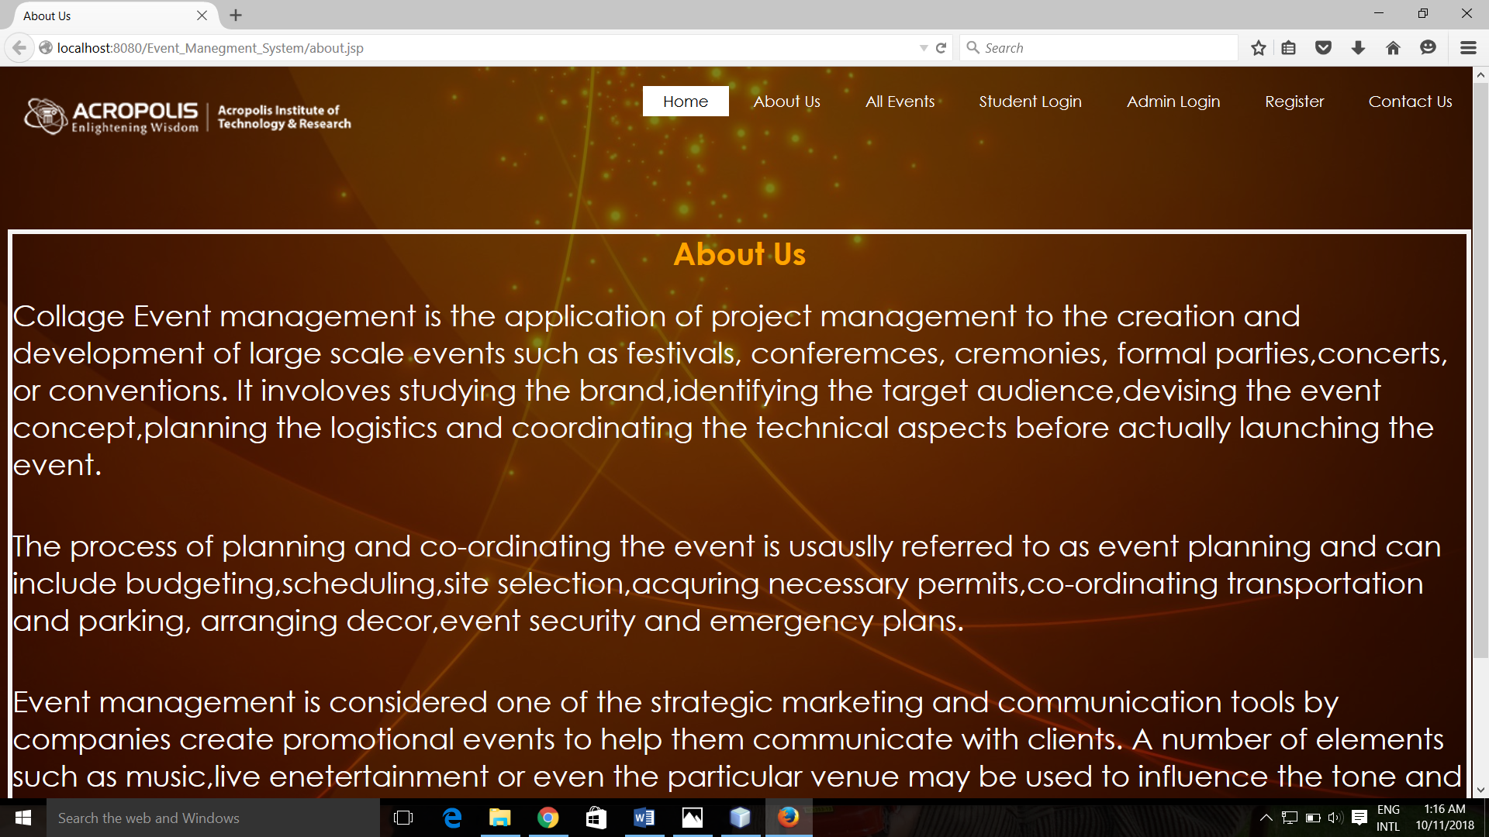

Slide 24
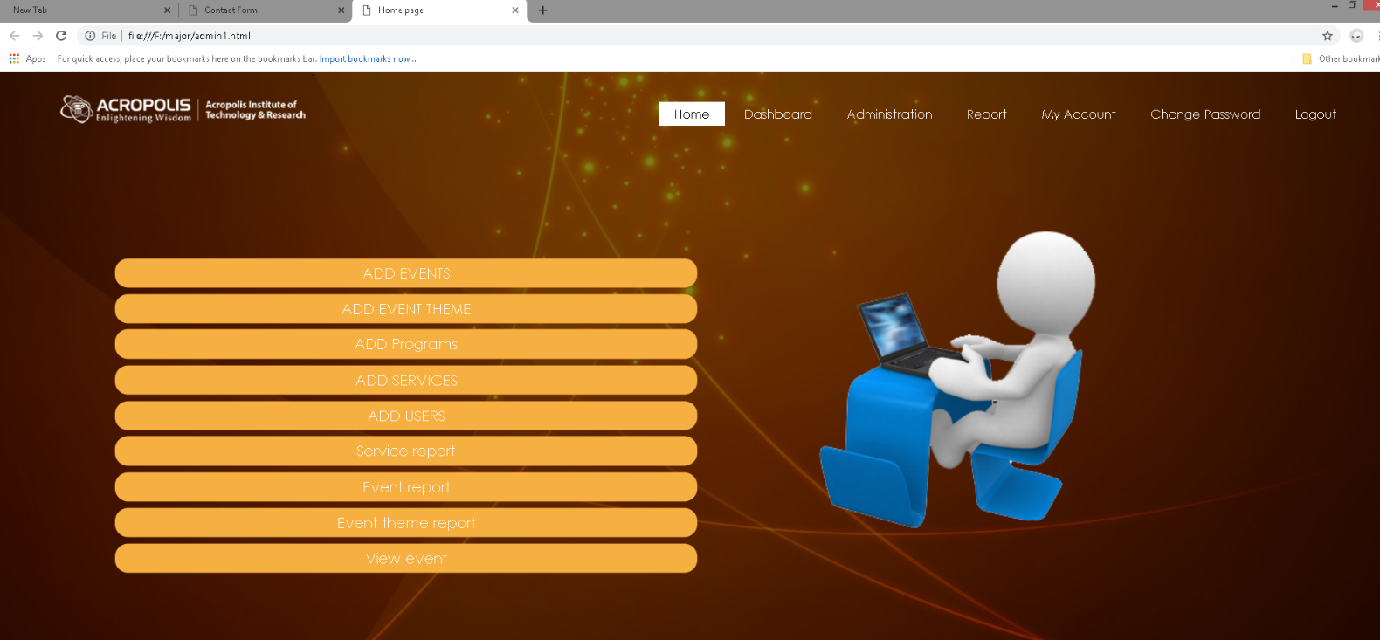

Slide 25
EXPECTED OUTCOMES
It will be great source of information and centralized platform.
The outcome of the proposed system will be, the communication gap between teacher and student coordinators will be reduced / minimized.
Students can view all events and can participate as per their interest.
The any changes affected in the schedule will be easily notified to all student coordinators and participants of the events.
Day to day reminders to participants about their event.

Slide 26
CONCLUSION
We have prepare new system after identifying issues in existing manual system. In which easy to use GUI is proposed by which Student coordinators, Staff coordinator can view all the records which are necessary. Participant students can view and register for events online. The record maintenance are use of previous records becomes easy and effective communication between staff coordinators and student coordinators. Thus we will implement College Event Organizer system to address the problem faced by event organizers with respect to communication and working methods.

Slide 27
LIMITATIONS
At presently it contains limited content and information.
It is only for the student of acropolis institute of technology & research and acropolis technical campus .
The web application is not responsive and a responsive API is needed.
Admin can not grant permission to user to add events.

Slide 28


